Slide 1
Student Performance Analysis & Prediction
Group ID : DMP28
Divij Shah | 19BCP037
Shram Kadia | 19BCP122
Smit Vekaria | 19BCP132

Slide 2
INTRODUCTION
Education is a key factor for achieving long-term economic progress. However, the poor statistics keep many countries on their tail due to their high student failure and dropping out rates. Over the decades, the education levels throughout the globe have improved systematically by providing ample opportunities for students to grab. On the other hand, throughout the generations student’s sincerity regarding studies have dropped drastically.
We developed a model which will help schools and universities to determine students' performances based on

Slide 3
INTRODUCTION
their daily behaviour. Using the obtained result, the administration could take steps in the betterment of the students' performances. They could analyse how a particular student is performing and what are the factors that are contributing to it. Using this information they could implement changes in the teaching methodology or they could give more attention to weak performing students and help them at a more intimate level.

Slide 4
DATASET
We have used a dataset from the UCI machine learning repository. The dataset is named ‘Student performance dataset’ which shows records of performances of high school students. The dataset contains 649 instances and 33 attributes.
The data attributes include student grades, demographic, social and school related features. The target attribute G3 has a strong correlation with attributes G2 and G1. This occurs because G3 is the final year grade, while G1 and G2 correspond to the 1st and 2nd period grades.

Slide 5
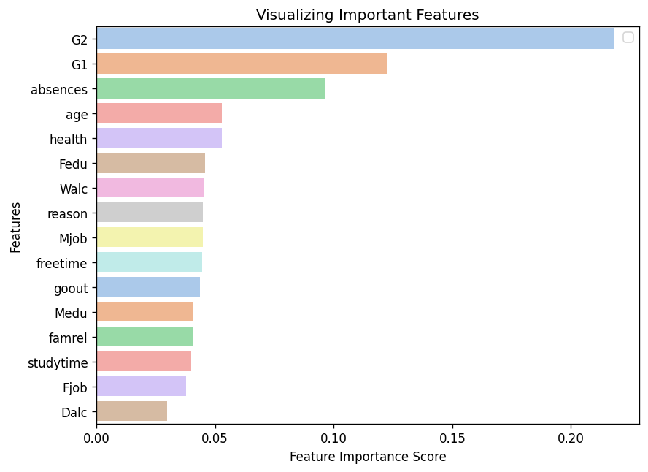
FEATURE IMPORTANCE

Slide 6
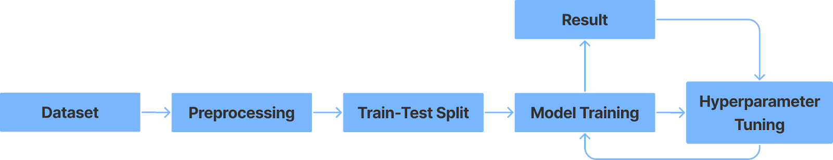
ARCHITECUTRE

Slide 7
MODEL ACCURACY
 | BEFORE TUNING | AFTER TUNING
RMSE Score | 4.5316 | 1.1645

Slide 8
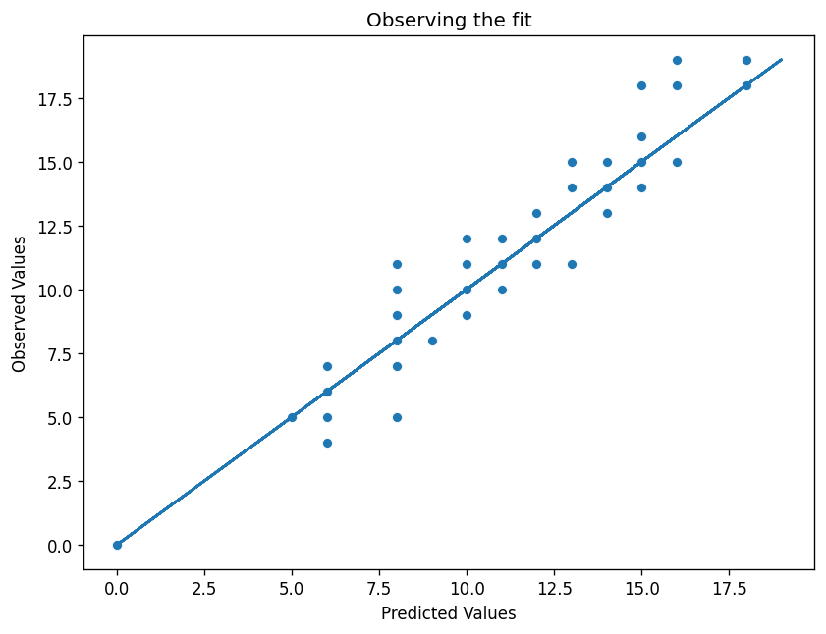
VISUALIZING THE PREDICTED VALUES FIT

Slide 9
CONCLUSION
To conclude, we took the data, pre-processed it, fed it to the learning model, tweaked its hyperparameters, predicted the values and checked the accuracy. Now the predicted values can be further utilised to solve the targeted domain.
Based on our predictions, the school can now help the students get better grades after analysing their situations and take some effective measures in the same direction. It will also help them to identify which students need to pay more attention in their education and the reasons behind their low grades can also be obtained which ultimately makes the work of the faculties easier.

Slide 10

THANKS!
Any questions?

